Slide 1





KDU Southern Campus MI
KDUSC- MI Medical Report Generating System
Group No.03

Slide 2

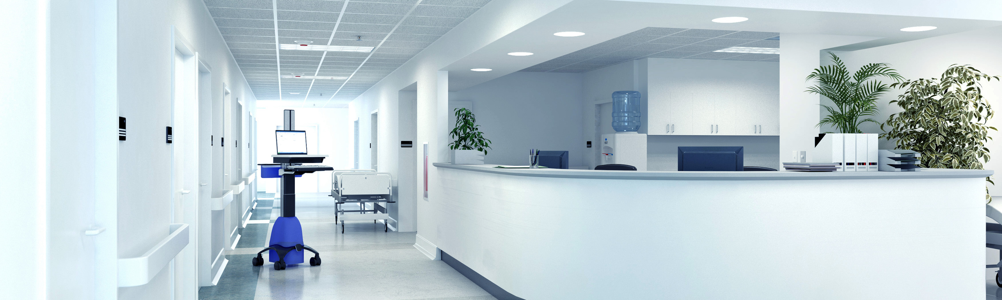
Introduction
The project aims to develop a medical report-generating system for KDU Southern Campus, utilizing a database for retrieving written information.
The system will handle student information and automate procedures, reducing waiting times, improving record-keeping, and enhancing health and safety.
By leveraging technology, the system aims to streamline medical record generation, ensure accurate record-keeping, and optimize resource allocation.

Slide 3
FUNCTIONAL REQUIREMENTS
Management Assistant should be,
get student uploaded medicals and form details.
notified about the approved medicals.
get the calculation of number of approved medical days per student as .
Medical inspection staff should be able to,
add users (student and Admins to the system.
update doctor availability.
Students should be able to,
attach medicals and other relevant documents.
check previously approved medical reports.
student contacting admin (MI) through E-mail.
HOD should be able to,
give his approval.
Assistant Registrar should be able to,
give his approval.
Doctor should be able to,
give approval or reject the medical.
update doctor availability.

Slide 4

Group Details
Group Number: 3 | Student Number | Student Name
 | D/BIS/22/0009 | PKP Radeeshan
 | M/IT/OFF002 | NMK Wickramaranthna
 | D/BIT/22/0043 | RMS Laknath
 | D/BIT/22/0005 | NHV Raveena
 | D/BIT/22/0027 | RAKS Lakshani
 | D/BIS/22/0016 | KGR Minulka

Slide 5

THANK YOU!

